Slide 1
Friend functions

Slide 2
Access privileges in C++.
You have access privileges in C++ such as public, protected and private that helps in encapsulation of data at various level.

Slide 3
Private
If data are declared as private in a class then it is accessible by the member functions of the class where they are declared. The private member functions can be accessed only by the members of the class. By default, any member of the class is considered as private by the C++ compiler, if no specifier is declared for the member.
Public
The member functions with public access specifier can be accessed outside of the class. This kind of members is accessed by creating instance of the cass.

Slide 4
Protected
Protected members are accessible by the class itself and it's sub-classes. The members with protected specifier act exactly like private as long as they are referenced within the class or from the instance of the class. This specifier specially used when you need to use inheritance facility of C++. The protected members become private of a child class in case of private inheritance, public in case of public inheritance, and stay protected in case of protected inheritance.

Slide 5
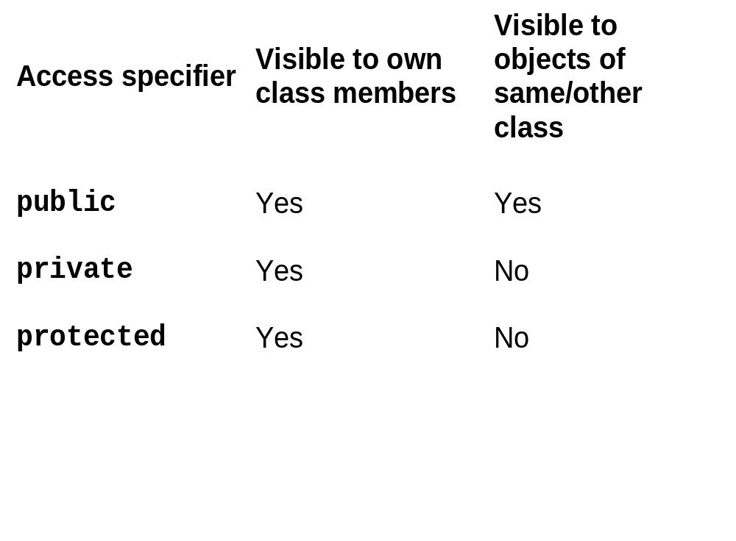

Slide 6
When we want our private data to be shared by a non member function
Then:
Basically, we declare something as a friend, you give it access to your private data members.
Single functions or entire classes may be declared as friends of a class.

Slide 7
A Friend function is a non-member function of the class that has been granted access to all private members of the class.
We simply declare the function within the class by a prefixing its declaration with keyword friend.
Function definition must not use keyword friend.
Definition of friend function is specified outside the class body and is not treated as a part of the class.
The major difference b/w member function and friend function is that the member function is accessed through the object while friend function requires object to be passed as parameter.

Slide 8
Syntax:
class ABC
{
………….
public:
friend void xyz(object of class);
};

Slide 9
Friend function characterstics
It is not in scope of class.
It cannot be called using object of that class.
It can be invoked like a normal function.
It should use a dot operator for accessing members.
It can be public or private.
It has objects as arguments.
Perhaps the most common use of friend functions is overloading << and >> for I/O.

Slide 10
Example
class demo
{
int x;
public:
demo(int a)
{
x=a;
}
friend void display(demo);
};

Slide 11
void display(demo d1)
{
cout<<d1.x;
}
void main()
{
demo d2(5);
display(d2);
}

Slide 12
class sample
{
int a;
int b;
public:
void setval(){ a=25,b=40}
friend float mean(sample s);
};
float mean(sample s)
{ return (s.a+s.b)/2.0;
}
void main()
{ sample X;
cout<<mean(X);
}

Slide 13
Friend class
In previous section of class we declared only one function as a friend of another class.but it is possible that all member of the one class can be friend of another class.this is friend class

Slide 14
Friends (a few gory details)
  Friendship is not inherited, transitive, or reciprocal.
  Derived classes don’t receive the privileges of friendship (more on this when we get to inheritance in a few classes).
  The privileges of friendship aren’t transitive. If class A declares class B as a friend, and class B declares class C as a friend, class C doesn’t necessarily have any special access rights to class A.
  If class A declares class B as a friend (so class B can see class A’s private members), class A is not automatically a friend of class B (so class A cannot necessarily see the private data members of class B).
  Friendship is not inherited, transitive, or reciprocal.

Slide 15
Example
class demo
{
private:
int x,y;
public:
demo(int a,int b)
{
x=a;
y=b;
}
friend class frnd;
};

Slide 16
class frnd
{
public:
void display(demo d1)
{
cout<<“x is=”d1.x;
cout<<“y is=”d1.y;
}
};

Slide 17
void main()
{
demo d2(10,40);
frnd f1;
f1.display(d2);
getch();
}

Slide 18
This pointer
Every object in C++ has access to its own address through an important pointer called this pointer. The this pointer is an implicit parameter to all member functions. Therefore, inside a member function, this may be used to refer to the invoking object.
Friend functions do not have a this pointer, because friends are not members of a class. Only member functions have a this pointer.

Slide 19
class Employee
{
private:
string name;
double salary;
public:
Employee();
Employee(string n, double s);
string getName();
double getSalary();
};

Slide 20
Employee::Employee() : name(""), salary(0) {}
Employee::Employee(string n, double s): name(n), salary(s) {}
string Employee::getName() {
return name;
}
double Employee::getSalary() {
return salary;
}

Slide 21
class Boss
{
private:
Employee e;
public:
Boss();
void giveRaise(double amount);
};
Boss::Boss() {}
void Boss::giveRaise(double amount)
{
e.salary = e.salary + amount;
cout << e.salary << endl;
}

Slide 22
class Employee
{
private:
friend class Boss;
string name;
double salary;
public:
Employee();
Employee(string n, double s);
string getName();
double getSalary();
};

Slide 23
Virtual Function
A virtual function a member function which is declared within base class and is re-defined (Overriden) by derived class.
Virtual functions ensure that the correct function is called for an object, regardless of the type of reference (or pointer) used for function call.
They are mainly used to achieve Runtime polymorphism
Functions are declared with a virtual keyword in base class.
The resolving of function call is done at Run-time.

Slide 24
Rules for Virtual Functions
They Must be declared in public section of class.
Virtual functions cannot be static and also cannot be a friend function of another class.
Virtual functions should be accessed using pointer or reference of base class type to achieve run time polymorphism.
The prototype of virtual functions should be same in base as well as derived class.

Slide 25
They are always defined in base class and overridden in derived class. It is not mandatory for derived class to override (or re-define the virtual function), in that case base class version of function is used.
A class may have virtual destructor but it cannot have a virtual constructor.

Slide 26
Compile-time(early binding) VS run-time(late binding) behavior of Virtual Functions
using namespace std;
class base
{
public:
virtual void print ()
{ cout<< "print base class" <<endl; }
void show ()
{ cout<< "show base class" <<endl; }
};

Slide 27
class derived:public base
{
public:
void print ()
{ cout<< "print derived class" <<endl; }
void show ()
{ cout<< "show derived class" <<endl; }
};

Slide 28
int main()
{
base *bptr;
derived d;
bptr = &d;
//virtual function, binded at runtime
bptr->print();
// Non-virtual function, binded at compile time
bptr->show();
}

Slide 29
Runtime polymorphism is achieved only through a pointer (or reference) of base class type.
Also, a base class pointer can point to the objects of base class as well as to the objects of derived class.
In above code, base class pointer ‘bptr’ contains the address of object ‘d’ of derived class.

Slide 30
Working of virtual functions(concept of VTABLE and VPTR)
As discussed here , If a class contains a virtual function then compiler itself does two things:
If object of that class is created then a virtual pointer(VPTR) is inserted as a data member of the class to point to VTABLE of that class. For each new object created, a new virtual pointer is inserted as a data member of that class.
Irrespective of object is created or not, a static array of function pointer called VTABLE where each cell contains the address of each virtual function contained in that class.

Slide 31
